Slide 1
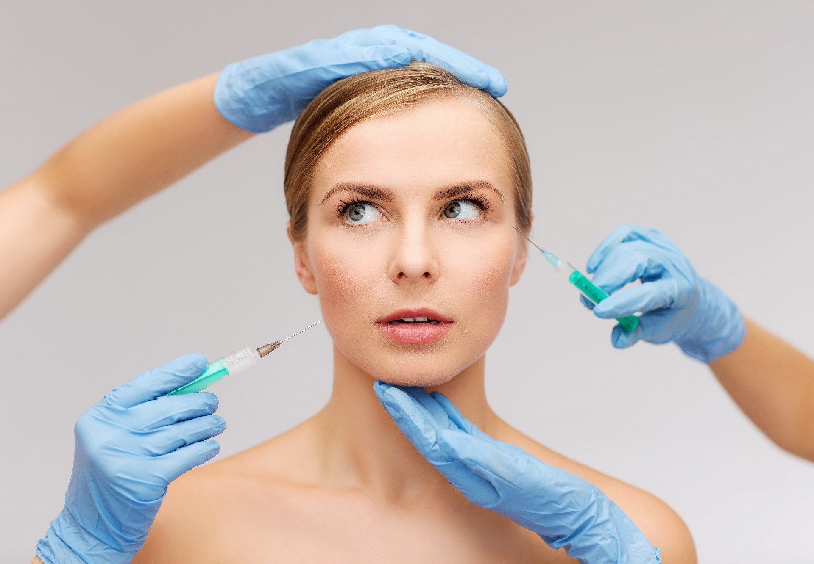
Cosmetic Surgeons Facebook ads case study by feras elghandour

Slide 5
Thank You

